Slide 1
Campus Pooling using OSM

Slide 2
CONTENTS
In this presentation:
Problem Definition
Objectives of Project
Project Flow
Results and Discussion
Conclusion
2

Slide 3
Introduction
Carpooling is the sharing of car journeys so that more than one person travels in a car. Carpooling reduces each person's travel costs such as: fuel costs, tolls, and the stress of driving, reduces air pollution, traffic congestion on the roads, and the need for parking spaces.
The project is aimed to find the most optimized route between the rider’s location and campus picking up as many as possible people going to campus, minimizing the distance factor. For this, we are getting a small area of map surrounding campus from OSM (Open Street Map) to create our adjacency list.
OsmNX is used for converting map data to graph data and shortest paths using the Dijkstra’s Algorithm.
3

Slide 4
Objectives of Project
To devise a car pooling algorithm that can help the students reach campus.
Using real world maps to implement the algorithm.
Finding optimal path given constraints of location and distance.
Creating a user interface to demonstrate the algorithm.
4

Slide 5
Project Flow
In this section, we will discuss how the problem statement was approached and the flow of the project followed.
Importing map data
Generating graph for map
Defining pooling algorithm
Plotting obtained path
Creating User Interface
5

Slide 6
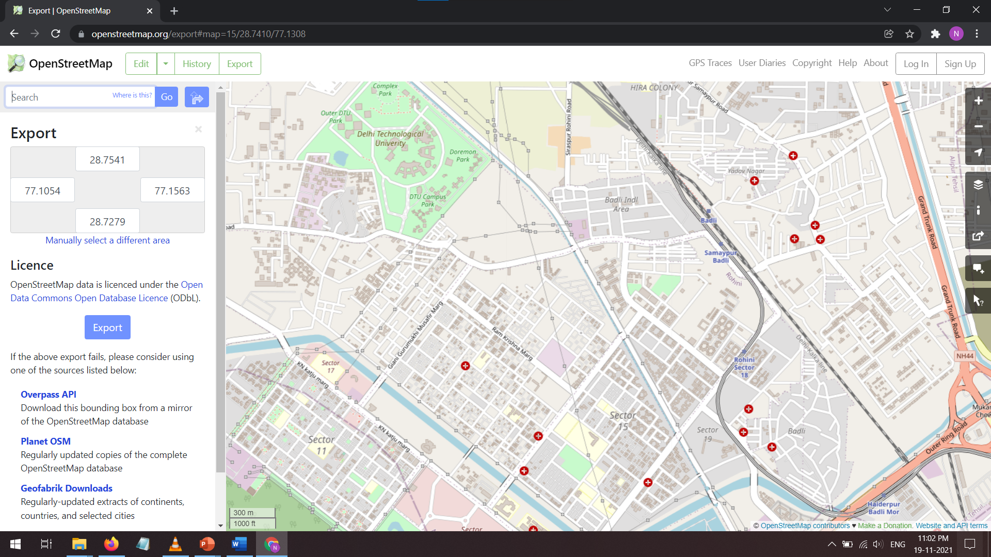
Importing map data
In our project we are considering map around DTU campus, where we used OSM (Open Street Maps) which is a community driven map service provider available free for use. We defined the coordinates for our map required region and the map was imported using osmnx library.
6

Slide 7
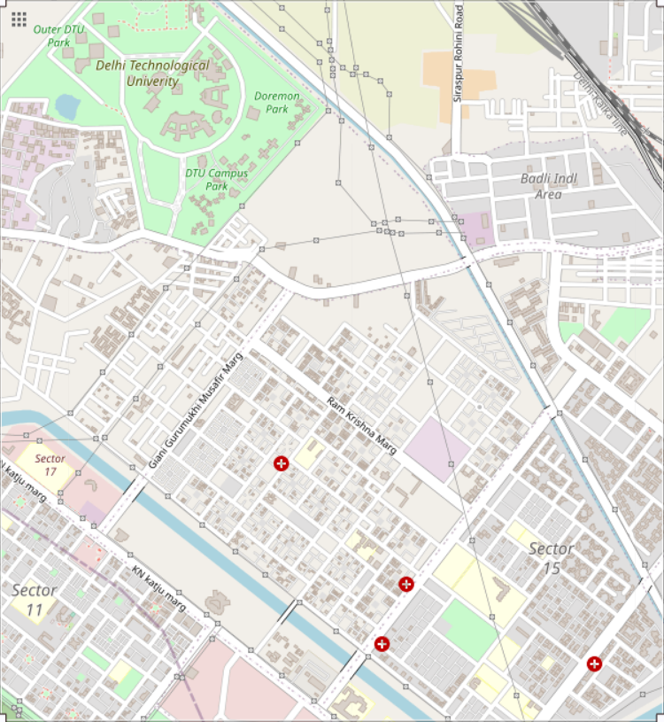
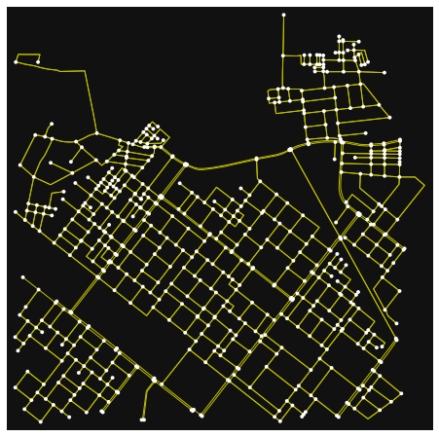
Generating graph object
To make use of path finding algorithms we need to convert our raw map data to a graph. For this, OSMnx, a Python package that lets us use geospatial data from OpenStreetMap and model it into graph objects was used.
7

Slide 8
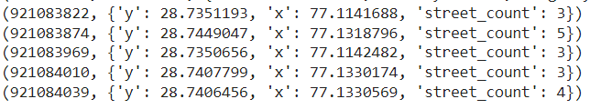
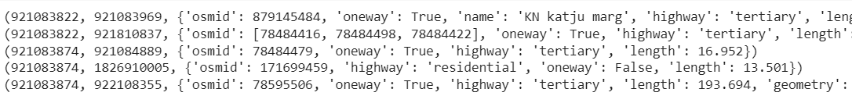
Generating graph object
The graph objects generated consist of nodes and edges details as given, from which required data were extracted to create the adjacency list.
Node Details example
Edge Details example
Graph model generated
8

Slide 9
Defining naïve pooling algorithm
The pooling algorithm used in our project takes in input the starting coordinates of our driver, and all the intermediate students coordinates to generate an optimal path to the destination which in our case is DTU campus.
The algorithm generates a list of all the possible shortest paths that could be taken by the driver, permutating all combination of pickups possible.
Dijkstra’s shortest path algorithm is used to calculate the shortest path to the destination node for all the combinations defined.
Constraints:
The maximum number of riders to be picked should be less than or equal to seating capacity of vehicle. For demo purpose we have assumed seating capacity as 3.
The maximum distance the driver will be travelling should not exceed 1.5 times its initial no pooling route.
9

Slide 10
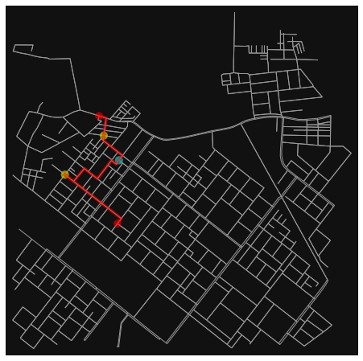
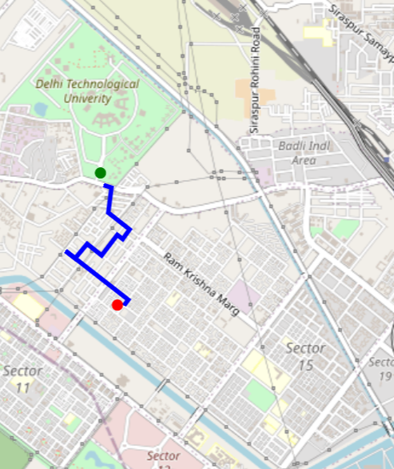
Results
Plotting obtained path: The path returned by the algorithm is in the form of list of node ids. These are converted to coordinates using osm map data, after which path is plotted that returns a map object with path.
10

Slide 11
Time Complexity
The time complexity for the given algorithm is:
O(N²) for dijkstra’s algorithm, where N is the number of nodes in the graph object derived from selected map region.
O(v choose r) = O(min(v^{r},v^{v-r})) for picking combinations of routes, where v is number of available intermediate pick up points and r is the seating capacity.
Hence, total time complexity will be O(min(v^{r},v^{v-r}) * N² ) .
11

Slide 12
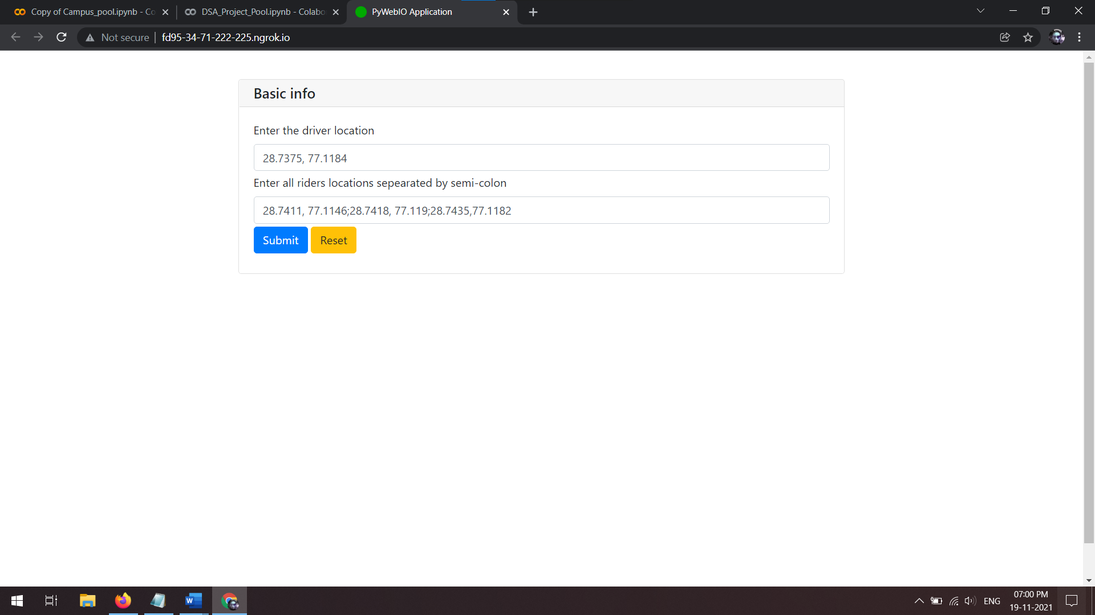
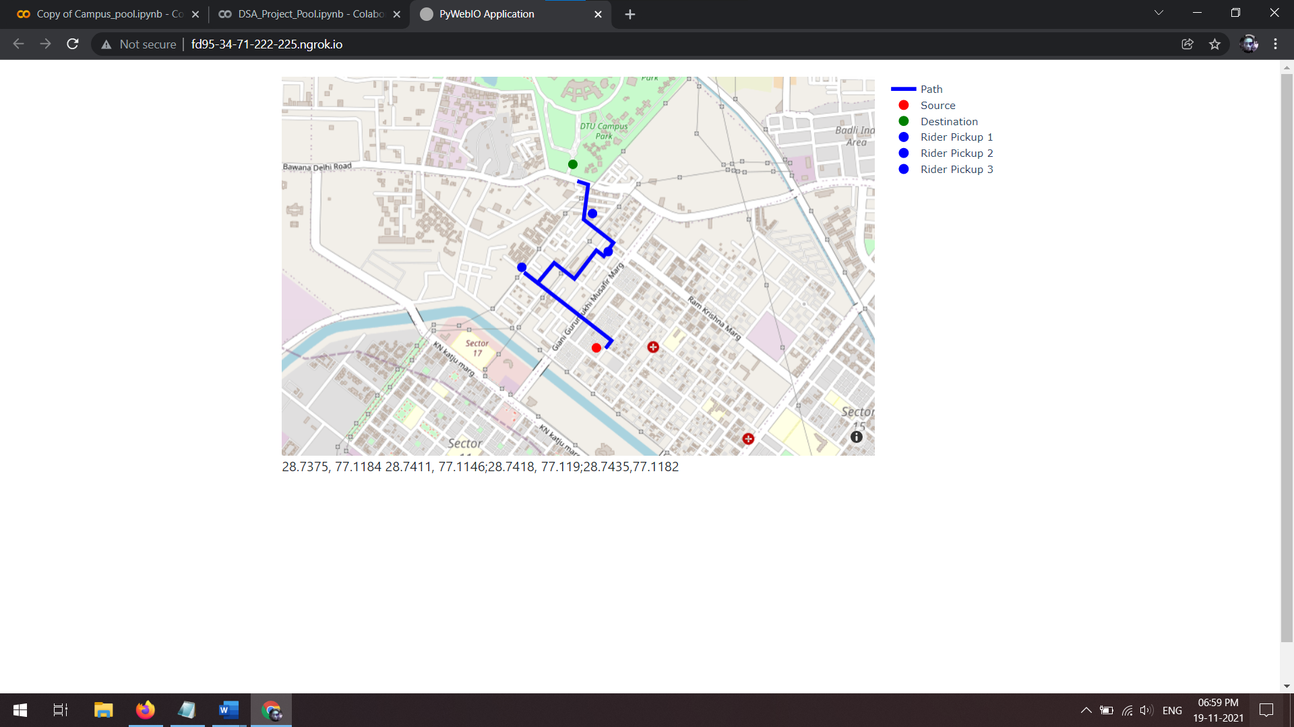
User Interface
For demonstration purpose, a web application user interface was created using a python library pywebIO, which is a python library that creates a web application without writing any html code. This allowed us to directly use our functions defined to visualize the project.
Input Screen
Output Screen
12

Slide 13
Conclusion
The project, Campus Pooling was aimed to find the most optimized route between the rider’s location and campus picking up as many as possible people going to campus, minimizing the distance factor.
Through this project we were able to use our knowledge on graphs and use it to solve a real-world problem, that in current scenarios we believe will be essentially more impactful with the increase in pollutions and parking problems.
This project can be further improved by implementing and experimenting other path finding algorithms and can be further deployed on mobile platforms for ease of use.
13

Slide 14
Thank You
Link for Code:
Campus Pool Project: https://colab.research.google.com/drive/1ITP83vT9kM8-at8Ame-jCNAZ7QgSRV-z
Project User Interface: https://colab.research.google.com/drive/1cyiYyi8NtO3e74G8pHVjty5Ah85r1ITy

